Slide 1
APCERT Asia Pacific Computer Emergency Response Team
Activities, Challenges & Collaboration
TLP:WHITE
Prepared by
APCERT Secretariat
February 2018
Notes:
As I am in charge of APCERT Secretariat business, I would like to talk about APCERT activities for global collaboration.
1

Slide 2
About APCERT
Asia Pacific Computer Emergency Response Team
http://www.apcert.org
Forum of CSIRTs/CERTs in the Asia Pacific region
Established in February 2003
30 Operational Members from 21 economies
New members: Bhutan (BtCIRT), CERT NZ
APCERT also has MOU/cooperative relationships with
STOP.THINK.CONNECT
TF-CSIRT (CSIRT community in Europe)
OIC-CERT (Organisation of Islamic Cooperation CERT)
APNIC
APCERT Vision Statement
APCERT will work to help create a Safe, Clean and Reliable cyber space in the Asia Pacific Region through global collaboration
Notes:
2

Slide 3
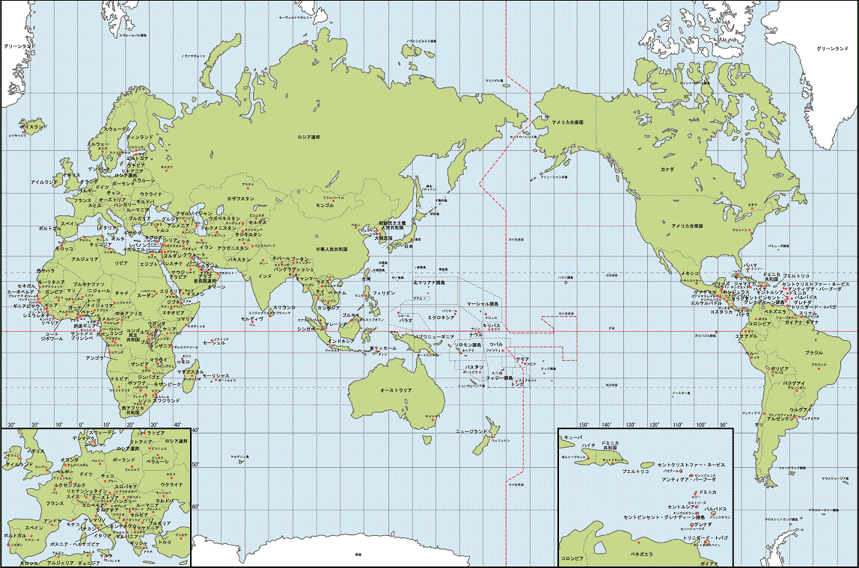
APCERT’s Outreach - Cross regional collaboration
FIRST
EGC
ENISA
TF-CSIRT
GFIRST
APEC-TEL
GCC-
CERT
OIC-CERT
AFNOG/AfriNIC/AfREN
APCERT
CLARA WG-CSIRT
Notes:
3

Slide 4
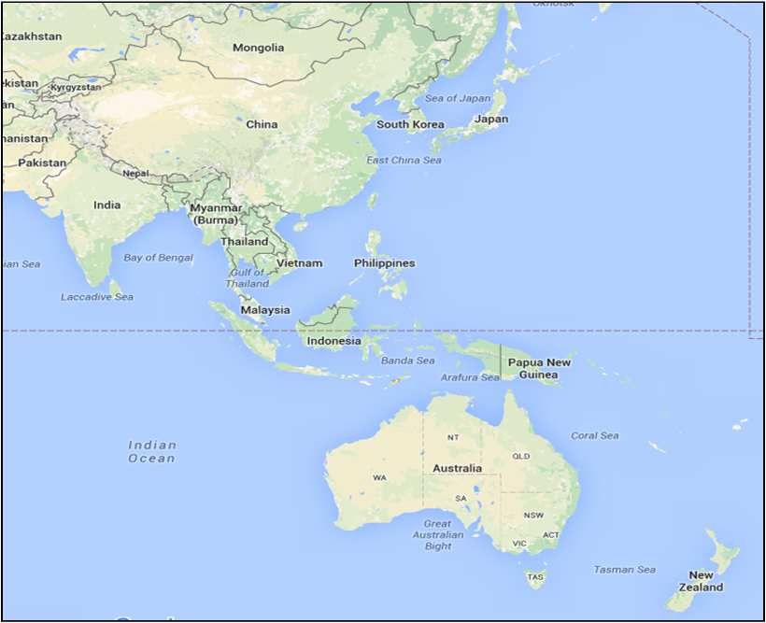
APCERT Operational Members (30 Teams from 21 Economies)
Mongolia
MNCERT/CC, MonCIRT
Japan
★JPCERT/CC
China
★CNCERT/CC, CCERT
South Korea
★KrCERT/CC
Bhutan
BtCIRT
Taiwan
★TWNCERT, TWCERT/CC, EC-CERT
Bangladesh
bdCERT, BGD e-Gov CIRT
Hong Kong
HKCERT, GovCERT.HK
India
★CERT-In
Macau
MOCERT
Myanmar
mmCERT
Vietnam
VNCERT
Sri Lanka
Sri Lanka CERT|CC, TechCERT
Brunei
BruCERT
Laos
LaoCERT
Indonesia
Id-SIRTII/CC, ID-CERT
Thailand
ThaiCERT
Australia
★CERT Australia(Chair), AusCERT
Malaysia
★MyCERT
New Zealand
CERT NZ
Singapore
SingCERT
Corporate Partners (3)
Bkav (Vietnam), Microsoft, Secureworks
★Steering Committee

Slide 5
APCERT OM Criteria
be a CERT from an Asia Pacific economy, which performs the function of a CSIRT or CERT on a full time basis
be a leading or national CERT within its own economy
be not-for-profit and/or wholly or partly government funded
have established policies, practices and procedures for operating a CERT within its economy and have experience in CERT operations including incident handling and cyber threat and vulnerability monitoring and advice
have a broad responsibility and capability for disseminating information and coordinating incident response across and/or among sectors within its economy
Obtain an OM sponsor, application and site visit

Slide 6
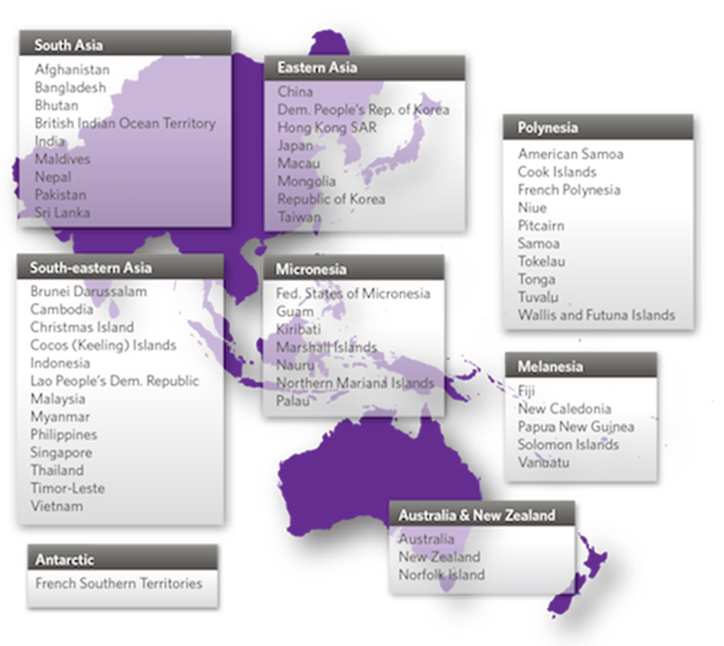
Asia-Pacific Region
Source: APNIC

Slide 7
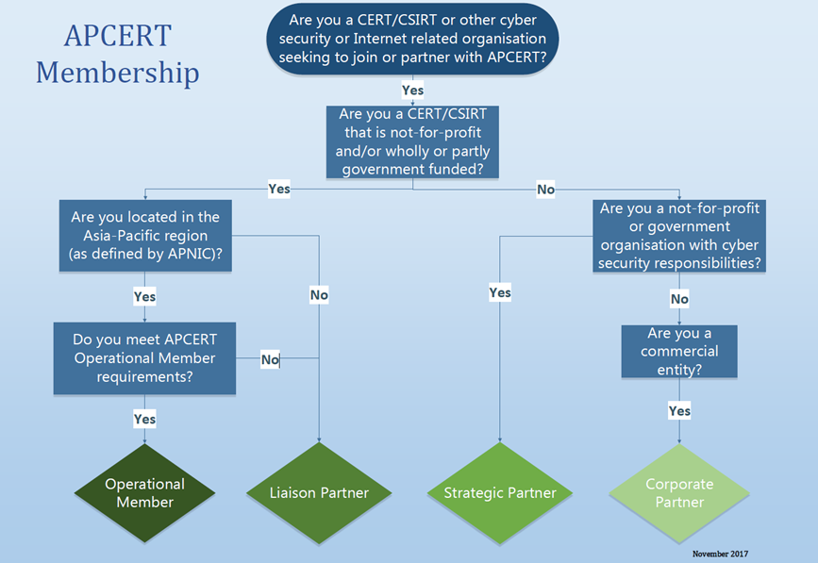

Slide 8
Why do we need APCERT?
Cyber threat landscape continues to evolve
Range of threats is ever increasing – seeing two distinct trends
Targeted: Increasingly sophisticated exploits are being developed and deployed against well-protected networks
Broad-based: Criminals compromising networks using publicly known vulnerabilities that have known mitigations (eg WanaCry)
Current challenges
Ransomware
Business Email Compromise / Social engineering
Targeting trusted third parties
DDoS
The challenges are not national – they are regional and global
Theft of money, data (corporate & personal) and intellectual property
Extortion attacks such as denial of service and ransomware
Malware hosted on compromised websites
Spear phishing emails / Business email compromise – network access & fraud
Notes:
8

Slide 9
APCERT Objective 1 – Security Cooperation
Encourage and support regional and international cooperation on information security in the Asia Pacific region
Jointly develop measures to deal with large-scale or regional network security incidents
Facilitate information sharing and technology exchange, including info security, computer virus and malicious code, among its members
Promote collaborative research and development on subjects of interest to its members

Slide 10
APCERT Objective 2 – Emergency Response
Assist other CSIRTs in the region to conduct efficient and effective computer security emergency response capability
Provide inputs and/or recommendations to help address legal issues related to information security and emergency response capabilities across regional boundaries

Slide 11
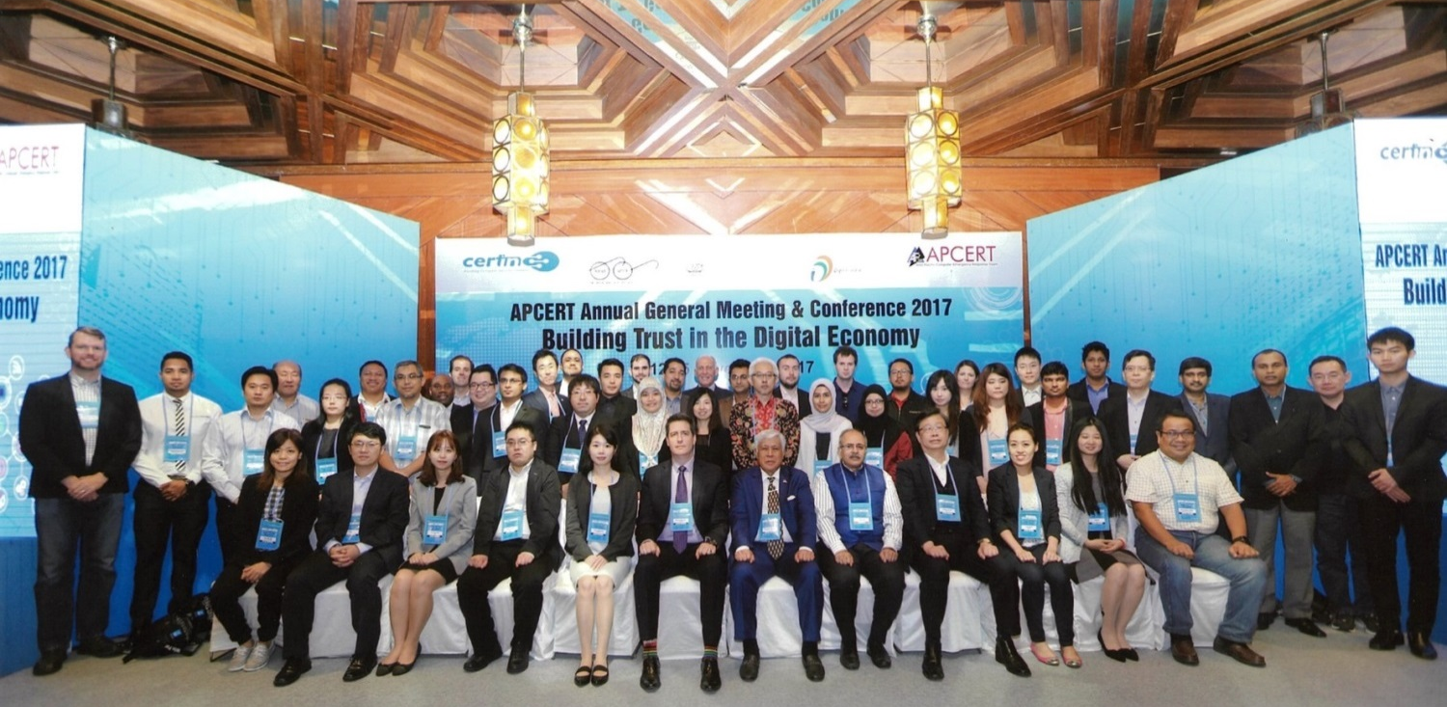
APCERT Objective 3 – Security Awareness
Organize and conduct an annual AGM and APCERT Conference to raise awareness on computer security incident responses and trends, exchange information on cyber security trends, discuss threats and challenges, and assist government & critical entities

Slide 12
How does APCERT work?
CSIRT (Computer Security Incident Response Team)
Independent from politics, industry, market…
Do not focus on WHO and WHY, focus on WHAT and HOW from a technical coordination perspective
CSIRT Common Policy
MY security depends on YOUR security
Web of trust
Systematic Handling
Timely manner
Each team has appropriate domestic contacts to handle and respond to incidents (ISPs, critical infrastructure, government…)
Mailing lists, Traffic Light Protocol, encrypted e-mail
Reaching to disconnected areas using CSIRT network
POC arrangement between members
One Point of Contact per economy
Deal with serious and time critical computer security incidents
Reachable 24 hours / 7 days via call
Notes:
12

Slide 13
APCERT Working Groups
Malware Mitigation WG (Convener: MyCERT)
To discuss security metrics in order to identify ways to improve on currently available security metrics, best practices on clean-up and data sharing methods
Information Sharing WG (Convener: CNCERT/CC)
To identify information regarded as useful for APCERT members and/or available to share with other APCERT members
Membership WG (Convener: KrCERT/CC)
To review the current membership criteria/classes
Policy, Procedures and Governance WG (Convener: CERT Australia)
To promote the Vision and Mission of APCERT, To review the Operational Framework and other documents
Training WG (Convener: TWNCERT)
To establish an overall education and training program to assist members to develop, operate, and improve their incident management capabilities.
TSUBAME WG (Convener: JPCERT/CC)
To exchange analytical information of TSUBAME, the packet traffic monitoring system to observe suspicious scanning activities in the Asia Pacific and other regions.
Drill WG (Convener: ThaiCERT)
To improve the efficiency and stability of the organization of the annual drill by maintaining a fixed organization that can learn from experiences each year.

Slide 14
Capacity Building
APCERT Online Training (bimonthly)
Date | Theme | Presenter
8 Feb 2017 | Digital Forensics | Sri Lanka CERT|CC
19 Apr | Mobile Vulnerability Check and Case Study | KrCERT/CC
1 Aug | Cyber Detection, Eradication and Forensic (Cyber D.E.F) | MyCERT
3 Oct | Cyber threat information sharing | CERT Australia
5 Dec | Introduction of DDoS Offensive and Defensive Exercise in Taiwan | TWNCERT
6 Feb 2018 | Malware Information Sharing Platform (MISP) in a CERT | AusCERT

Slide 15
Recent and upcoming Activities
Updated APCERT Operational Framework
New structure to include Partners
APCERT Information Classification Policy Update
Updating APCERT Information Classification Policy in line with the ‘FIRST Standards Definitions and Usage Guidance — Version 1.0’
Capacity Building Survey
Surveyed members in 2017 conducted to determine APCERT member strengths and gaps
Capacity Development WG to be established: will use the skills and expertise of APCERT Members/Partners to share experiences and strengthen the APCERT community
Events presented as APCERT Representative:
The OIC-CERT Annual General Meeting and Annual Conference
APRICOT / FIRST TC / AP*
APEC-TEL
Notes:
15

Slide 16
Recent and upcoming Activities - APCERT Drill
Practice – APCERT Incident Handling Drill
Conducted annually
Participation from most of APCERT teams and some external organisations
A simulation exercise of cyber attacks, includes communication checks based on given scenario.
Last Drill: 22 March, 2017
Theme: “Emergence of a New DDoS Threat ”
Participating Teams:
23 CSIRTs from 18 economies
4 CSIRTs from OIC-CERT
Objective/Scenario:
Mitigate DDoS incidents triggered by a type of malware which has been widely observed in the Asia Pacific region
Next Drill: 7 March 2018
Notes:
16

Slide 17
Recent and upcoming Activities - APCERT AGM & Conference
2017 APCERT AGM and Conference
Date: 12-15 November, 2017
Hosted by: CERT-In (India), Delhi
Theme: “Building Trust in the Digital Economy”
2018 APCERT AGM and Conference
Date: Q4 2018
Hosted by: CNCERT/CC (China), Shanghai
Theme: TBA
Notes:
17

Slide 18
APCERT Annual Report
Activity reports of APCERT member teams
Overview and activities of each team
Team reports and statistics on incidents and trends
Projects and Activities
Annual Report 2016 is available online
https://www.apcert.org/documents/pdf/APCERT_Annual_Report_2016.pdf
Annual Report 2017 will be available soon

Slide 19
Thank you!
APCERT General Contact:
apcert-sec@apcert.org
APCERT Website:
https://www.apcert.org
Notes:
19

